Slide 1
Create-A-Thon
Our Idea’s Submission for the Creative Coding Competition with 3D Graphics an Design.

Slide 2
CONTENTS
02
01
03
Abstract
Tools Used
Team Members
What is our idea?
04
Snapshots from our project

Slide 3
Aryan Singh Kushwaha: -
20BAI1288
2. Ibrahim Ahmed Siddiqui: -
20BAI1189​
3. Ratneshwar: -
20BAI1192​
01
Our Team Members

Slide 4
02. ABSTRACT
We are creating an interesting adventure, expedition, and
survival game.​
Try your best to survive this and prove your survival instinct by making the high score

Slide 5
Python
2. Pygame
3. Piskelapp
03
Tools Used

Slide 6
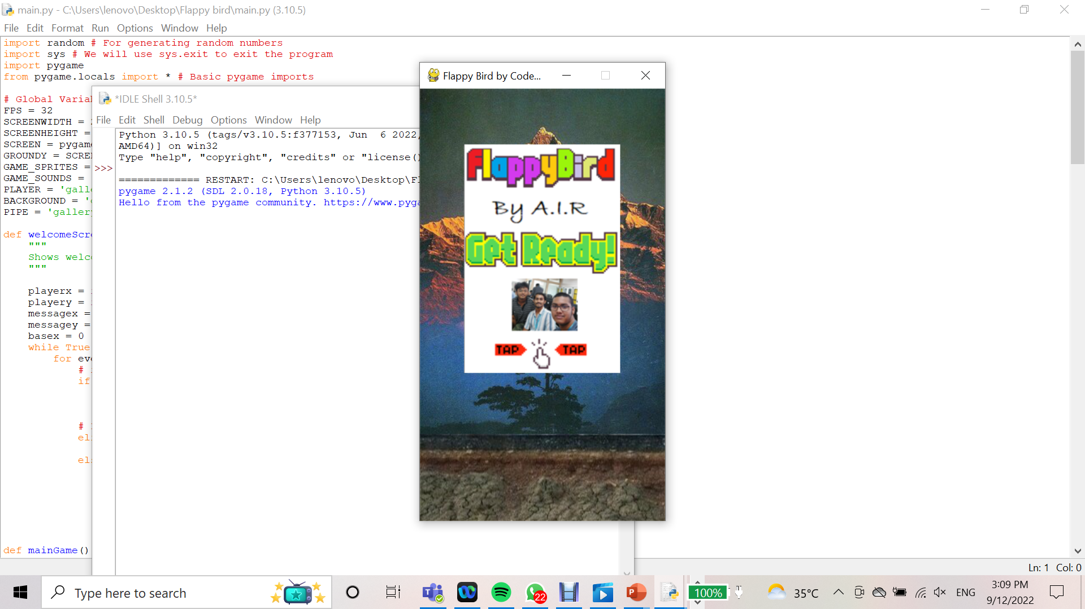
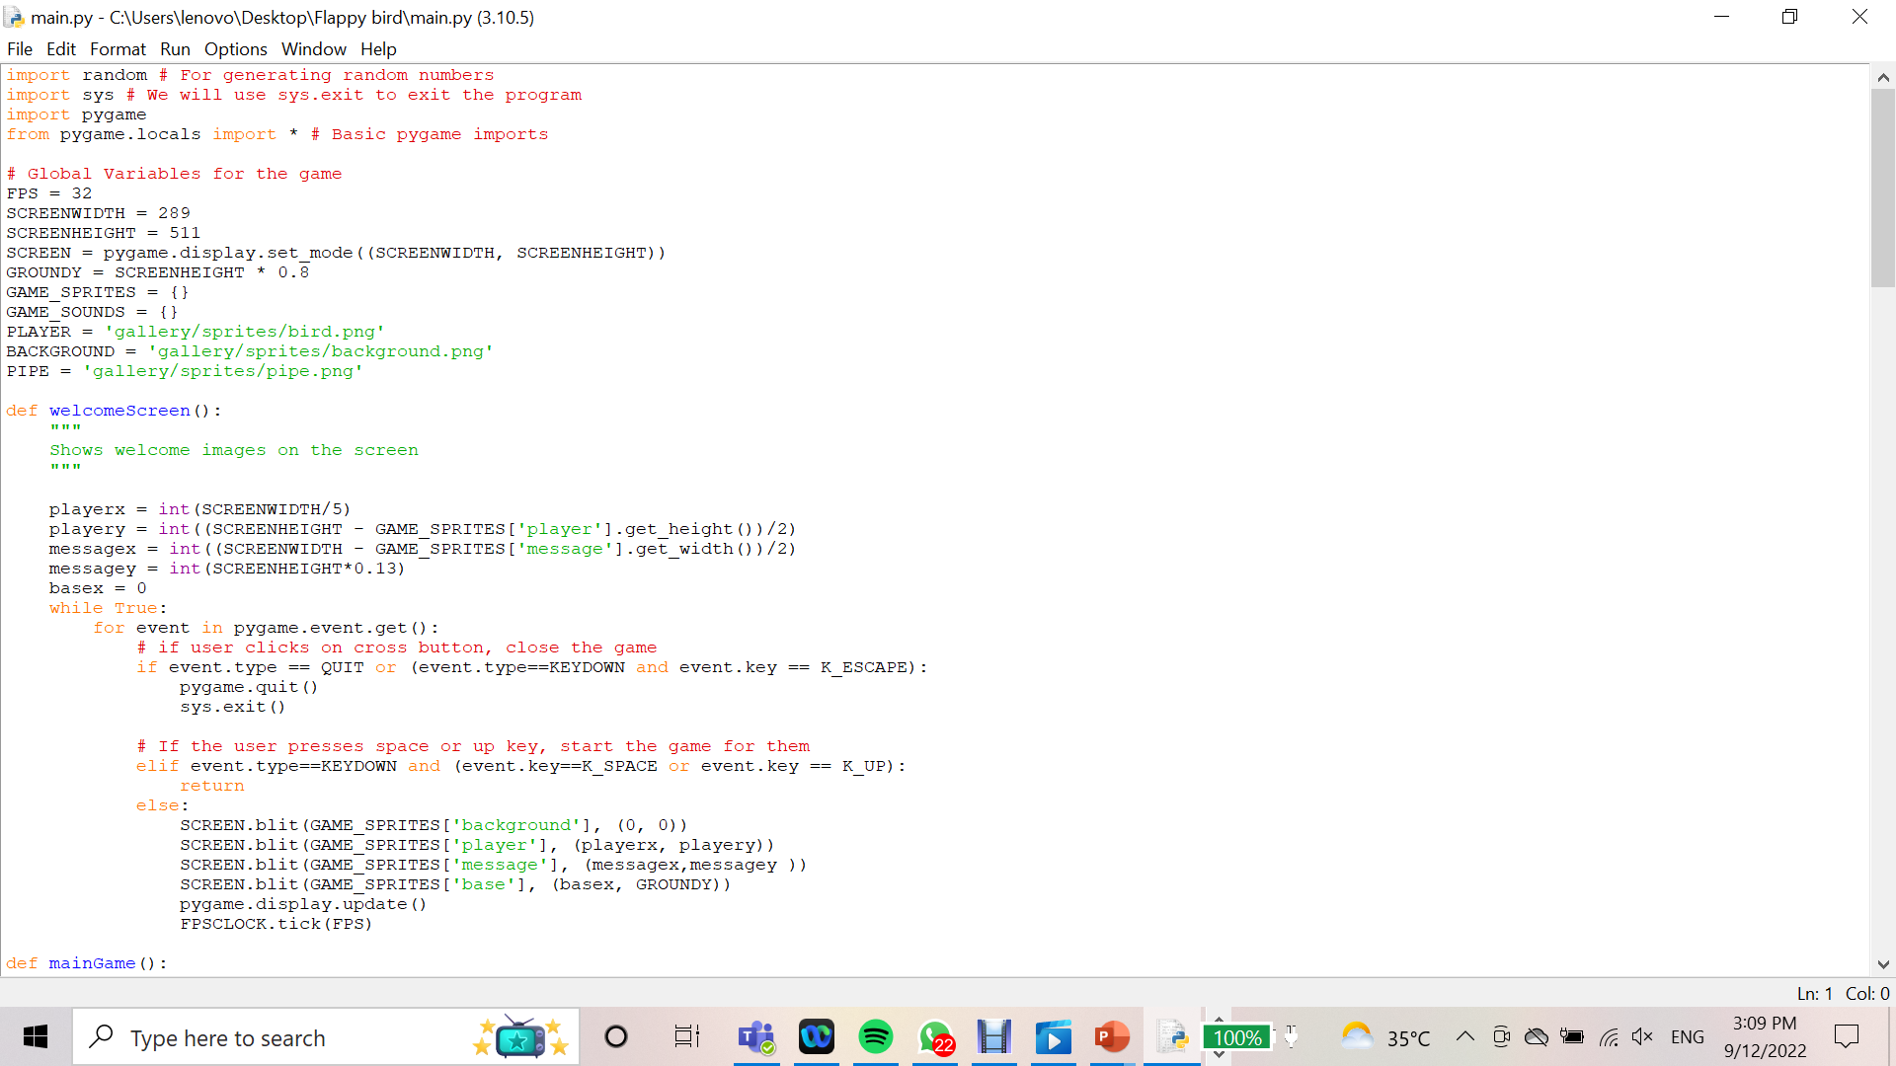
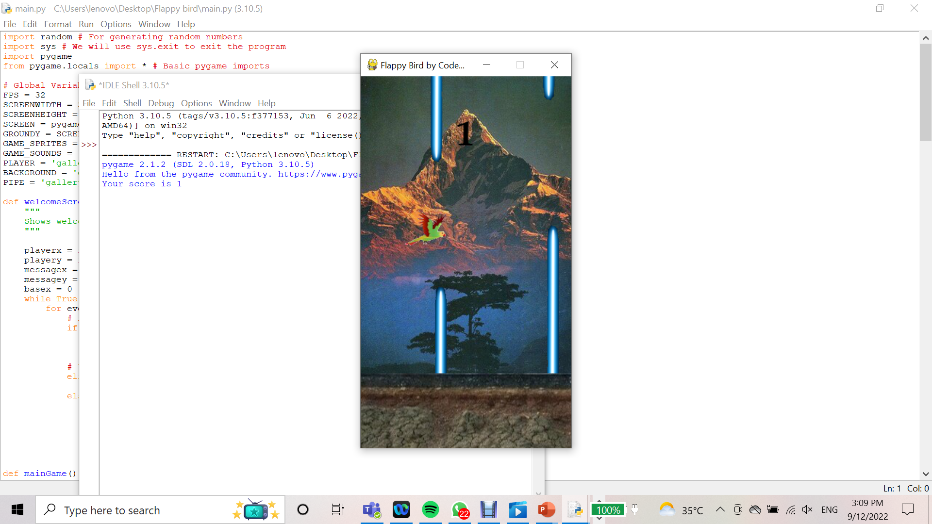
Snapshots from out project

Slide 7
THANK YOU

